Slide 1
SHAPES AROUND US

Slide 2
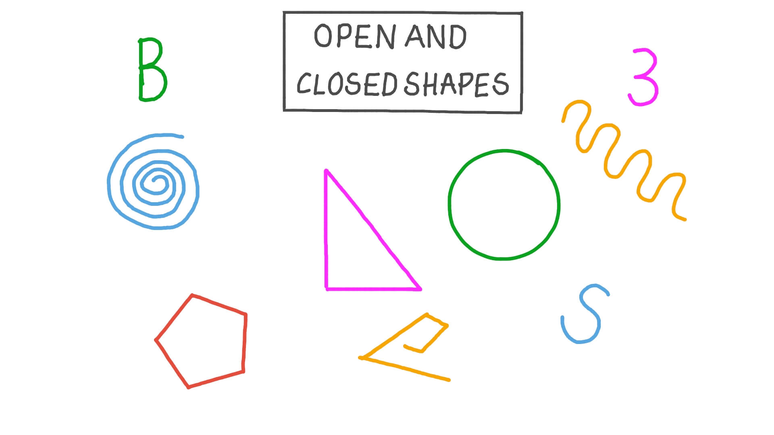
POLYGON
ALL the closed shapes that are made up of ONLY straight lines are called POLYGONS. A PLOYGON can have only number of sides.
A closed shape has an inside and outside. It can be made straight lines, curved lines, or a combination of the two.

Slide 4
A chord that goes through the centre of the circle is called a diameter.
The diameter is the longest chord that can be draw in a circle. All diameters of a circle are equal in length.
A line from the centre of a circle to a point on the boundary is called a radius. The plural of radius is radii.

Slide 5
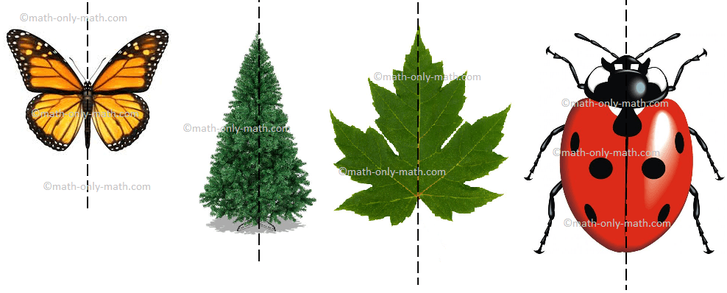
The line along which the mirror is placed is called a line of symmetry

Slide 6
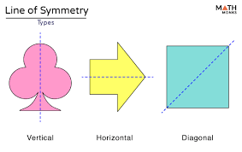
Types of symmetry

Slide 7
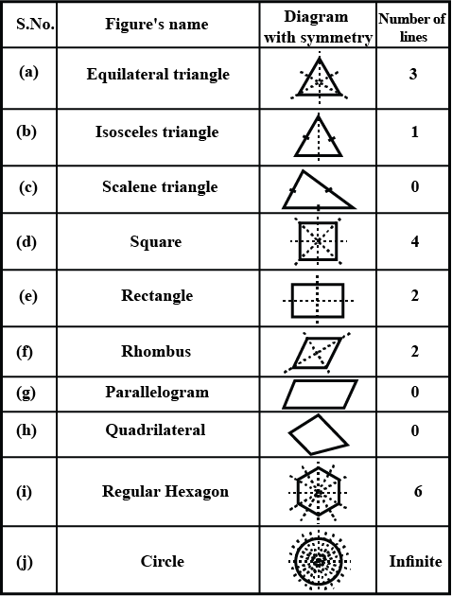

Slide 8
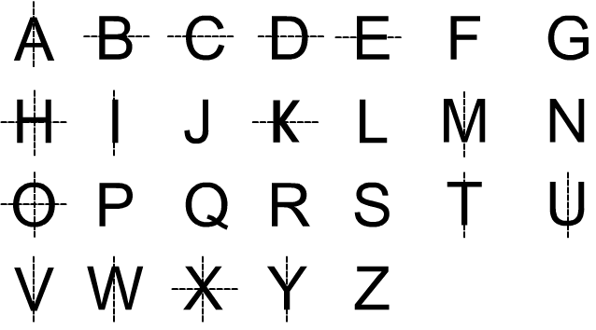
Alphabet symmetrical with respect to the dotted lines

Slide 9
Question time

